Slide 1
The XDS crisis: a spontaneously-arising stress test of our coordinated response capabilities
Gerard Bricogne & Collaborators
Global Phasing Ltd, Cambridge, UK
Day 2 of MXCuBE-ISPyB meeting, 18 November 2025, Diamond

Slide 2
XDS Watch: Autumn 2024 to Spring 2025
At the Diffraction Methods Conference 2024 (Berlin) a new version of XDS was informally communicated to Clemens Vonrhein. It was offering a new treatment of background estimation and of its use in integration.
Tests performed on-the-spot immediately showed problems via abnormal (“psychedelic”) aspects of many 2D STARANISO plots (out of autoPROC)
Given such ominous warning signs, we recommended postponing the release of this new version and sticking to the battle-tested 20230630 version (the resurrection of which we recommended throughout the subsequent chain of events) but this went mostly unheeded.
Further tests of the new version on numerous deposited raw image sets brought to light an abnormally high frequency of twinning diagnostics (a well-known symptom of problematic integrated intensities).
A succession of numerous releases of new XDS versions ensued, each closely scrutinized (unfortunately, after the fact) by us through an intensive testing and documentation activity, extending all the way to the 30th of April this year.

Slide 3
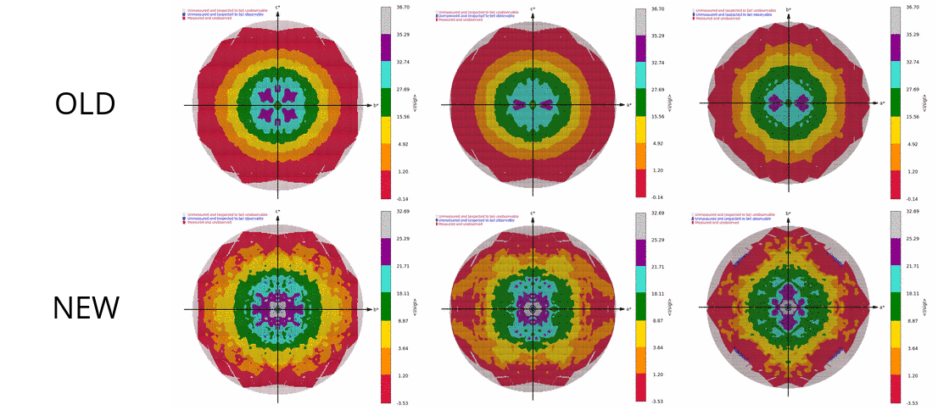
Workflow datasets: 20230630 vs. 20240723

Slide 4
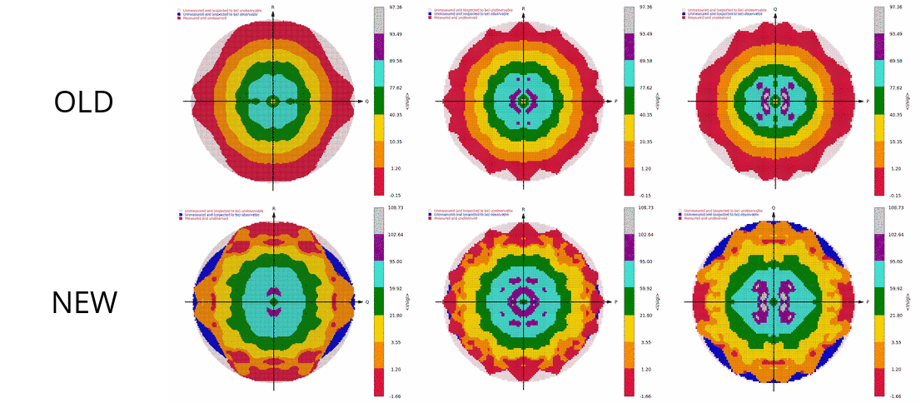
Workflow datasets: 20230630 vs. 20240723

Slide 5
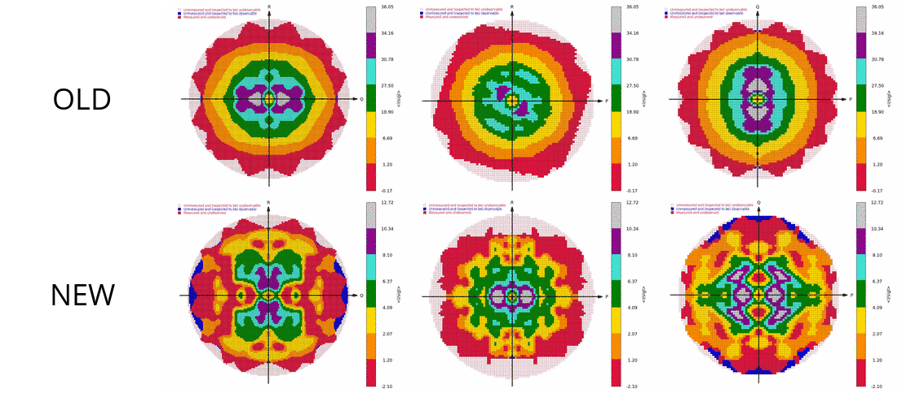
Workflow datasets: 20230630 vs. 20240723

Slide 6
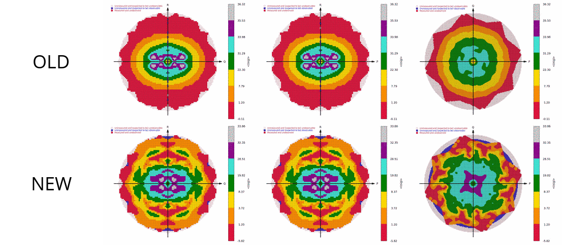
Workflow datasets: 20230630 vs. 20240723

Slide 7
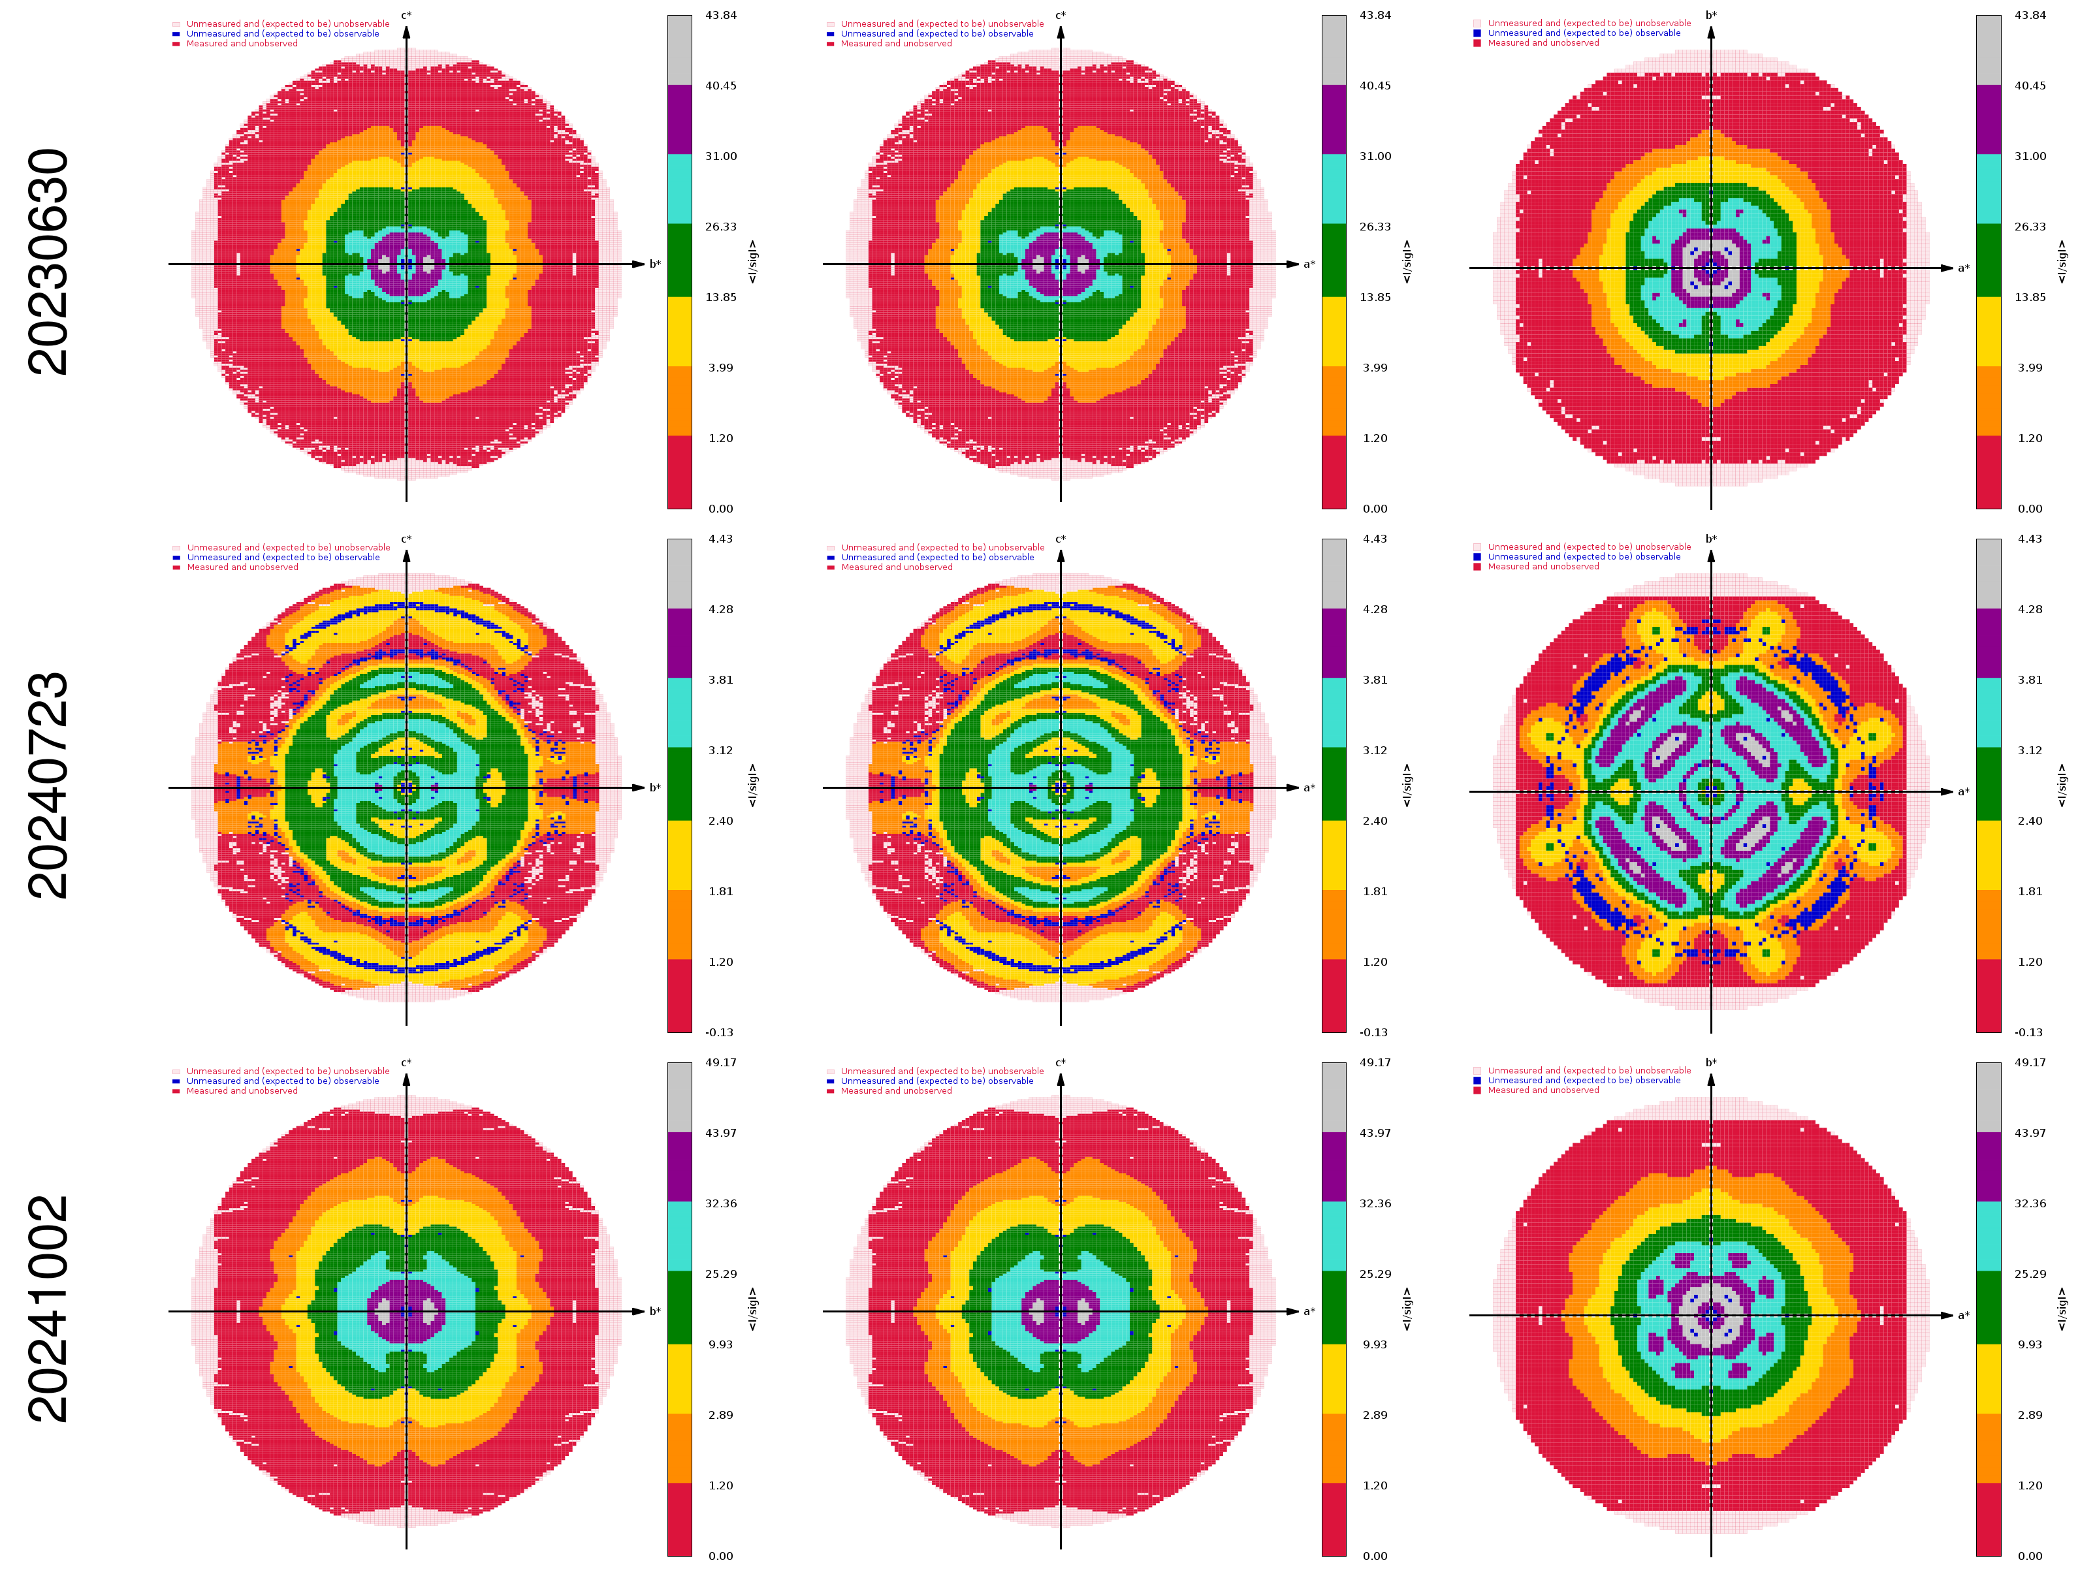
Encouraging signs: 20241002 on 8TCA, but …

Slide 8
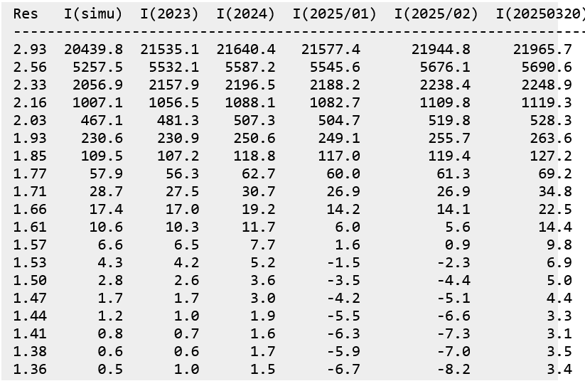
Numbers can say more than pictures …
Gleb Bourenkov (P14 beamline, PETRA III) ran tests using simulated images and detected biases in the intensities coming out post-20230630 XDS versions

Slide 9
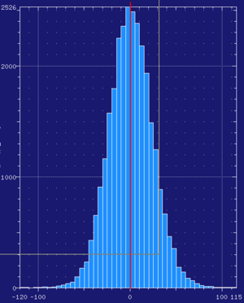
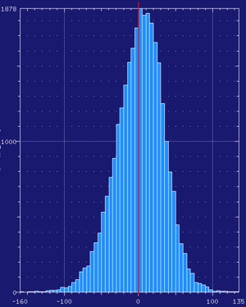
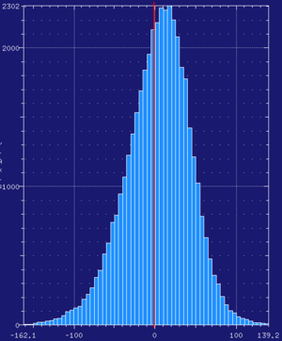
Summary as histograms (Gleb)
Distribution of intensities after integration of simulated images with very weak signal
2023
2024
20250320

Slide 10
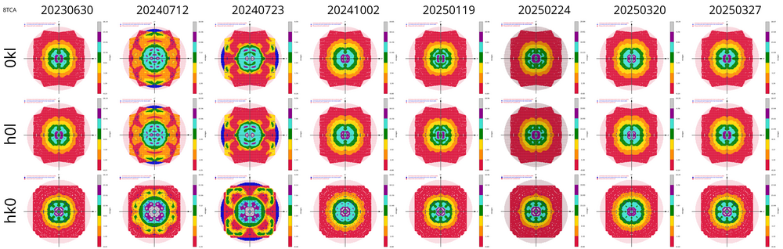
20250327 at last seemed to restore sanity …
From 20230630 (good) to 20250327* (good again) via six successive flawed binaries, each offered as a new release at the time
*just four days before the expiry of the extended-life “reference” 20230630.

Slide 11
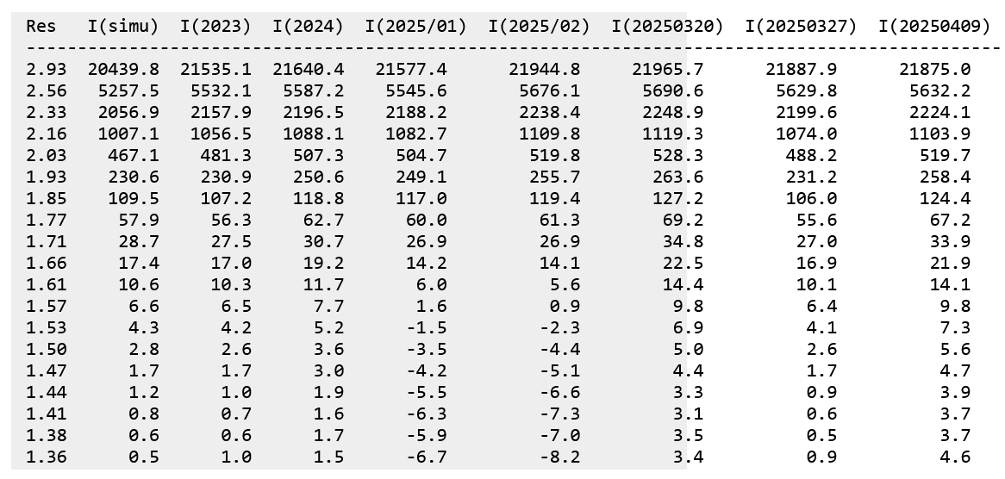
… only for chaos to return two weeks later
Fixed again by the latest (20250430) version. Note that both of the “good” ones (20230630 and 20250327) were unavailable in the interim period.

Slide 12
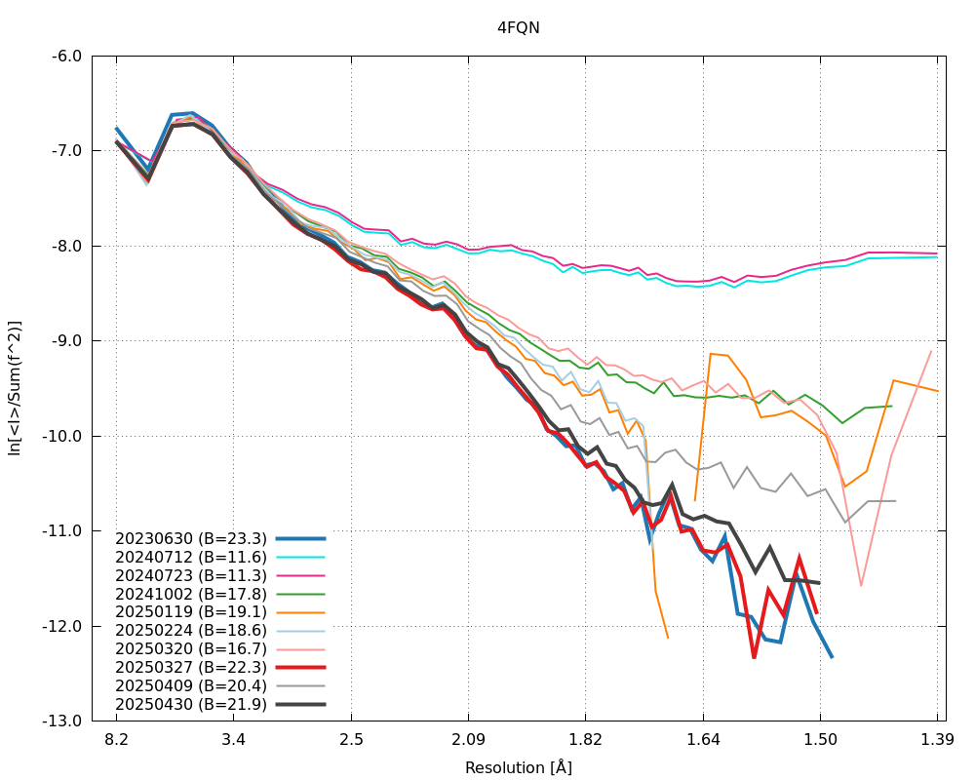
Retrospective: compared Wilson plots (4FQN)
A Wilson plot should be a straight line.
Note the aberrant plots that are upwardly curved, or even show an increase, at high resolution.
Conclusion: a lower Wilson B is not necessarily a sign of improved processing!

Slide 13
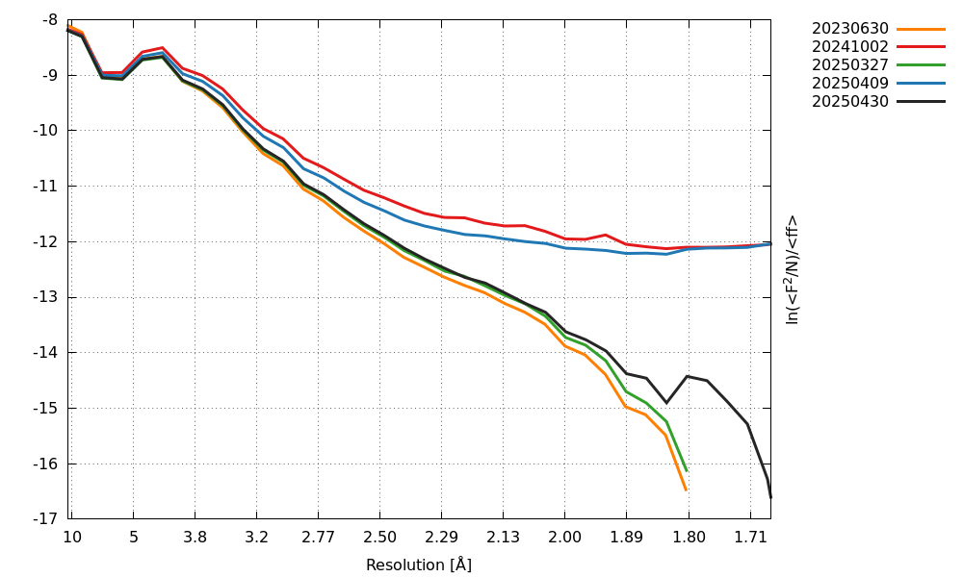
Data Quality Metrics for a dataset from Ashwin Chari
Note the aberrant Wilson plots for 20241002 and 20250409

Slide 14
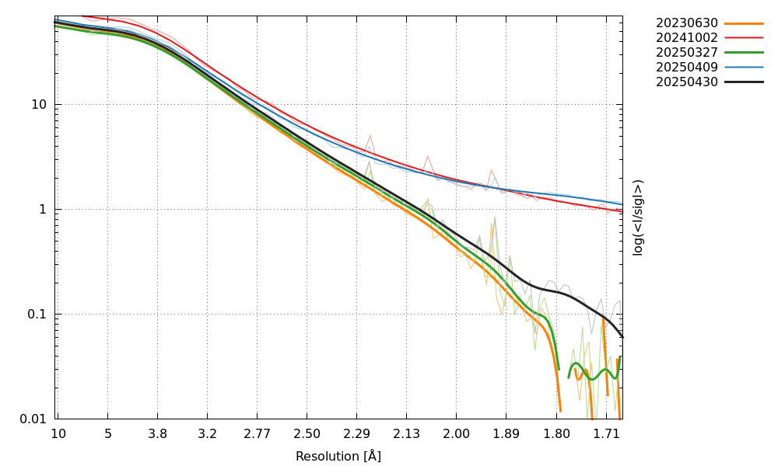
Data Quality Metrics for a dataset from Ashwin Chari
Note the strongly overestimated I/sig(I) values for 20241002 and 20250409, producing a misleading resolution estimate of 1.6Å while the true resolution is at best 2.0Å.

Slide 15
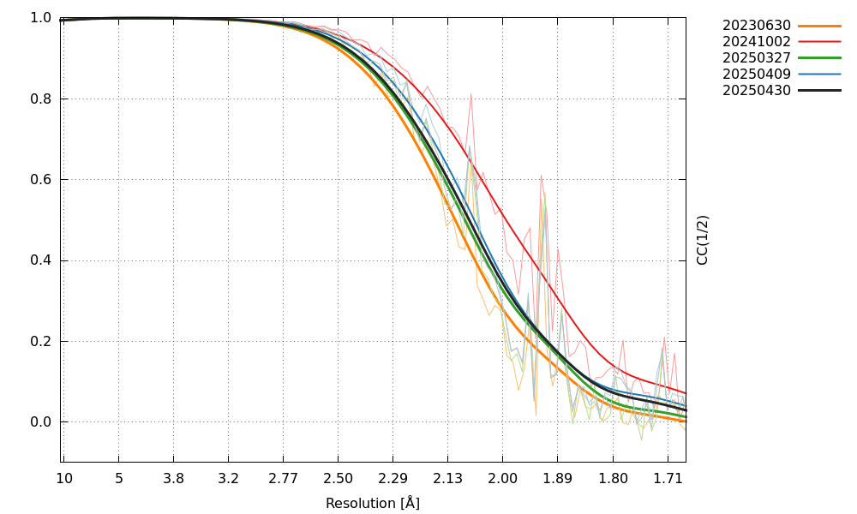
Data Quality Metrics for a dataset from Ashwin Chari
Note the strongly enhanced CC1/2 for 20241002. The unphysical Wilson plot, however, hints that this is an artefact, arguably caused by a systematic bias that is correlated between half-sets
Note: it was a high-resolution dataset collected by Ashwin Chari on Gleb’s P14 beamline that enabled Wolfgang Kabsch to identify the persistent bug in post-20230630 XDS versions

Slide 16

Déjà vu in cryo-EM

Slide 17
Feedback from Consortium member X
“I cannot stress enough how important this message was for us. Just one example:
The current 20250409 version (that we got in exchange for the 20250119 version that we received before) behaves 'funny' compared to our ancient 20210323 version:
Ellipsoidal cutoffs [A] : 3.6 -- 2.8 -- 2.9 (20210323)
Ellipsoidal cutoffs [A] : 3.2 -- 2.1 -- 2.2 (20250409)
Thank you very much for all your work! This is highly appreciated.”

Slide 18
Feedback from Consortium member Y
“We have been collecting data more or less weekly since the beginning of the year. I have checked a report.pdf file generated during the first data collection in each month:
08 May 2025VERSION Jun 30, 2024 BUILT=20241002
05 Apr 2025VERSION Jan 19, 2025 BUILT=20250327
06 Mar 2025VERSION Jun 30, 2024 BUILT=20241002
07 Feb 2025VERSION Jun 30, 2024 BUILT=20241002
25 Jan 2025VERSION Jun 30, 2024 BUILT=20241002
As far as I can tell, the XXXX was using BUILT=20241002 at the beginning of the year, switched to BUILT=20250327 at some point during spring, and has since reverted back to BUILT=20241002.”
Note: 20240112 is the version that strongly overestimated both I/sig(I) and CC1/2 at high resolution (spuriously so, as shown by the unphysical, upwardly curved Wilson plot) and was twice as slow as 20230630 (already notified by us at the time).

Slide 19
What do we collectively need to do better?
To minimize “inflammation” we limited our communication to those of our users who were directly affected via autoPROC’s reliance on XDS
we did not use the “nuclear option” of broadcasting our material to the CCP4BB: we only pointed to the relevant pages on our autoPROC Wiki if someone asked a question on the BB that was obviously related to that material.
This, however, limited communication to being one-way between us and three categories of users (Consortium members, contacts at synchrotrons using autoPROC, and academic users with an autoPROC licence)
Unless we missed something, we didn’t witness any other pro-active initiatives to warn users against using the latest XDS versions as they were coming out
Such problems were potentially very toxic towards data and derived results
This highlighted limitations still present in our communication with beamlines using autoPROC in their processing pipelines, even on such basic matters as
how autoPROC is invoked, and esp. what version of XDS is used
how/whether result files containing information not (or inadequately) displayed through the front-end are made available for download

Slide 20
Why this fixation on XDS?
During the 2008 financial crisis, many banks were deemed to be “too big to fail”: we hold a similar view that “XDS is too important to regress”.
Many thousands of datasets are processed every day with XDS, a very large fraction of them as part of industrial drug discovery projects.
Could we let a 2.0Å dataset get fobbed off as a 1.6Å dataset as a result of systematic positive bias in the integrated intensities, and trust that its use to obtain a scientific result (e.g. characterizing a ligand binding mode) will not be adversely affected?
Events since July 2024 reveal an unprecedented need for constant vigilance towards future versions of XDS, not just from end-users but also, and crucially, from beamline scientists, synchrotron staff and pipeline developers
Why not just leave it to the XDS developers?
They concentrated on trying to fix the bugs, but no warnings to users to prevent the waste of resources and contamination of results produced by versions we had shown to be buggy.
Only one message (to PhenixBB) on 3 Oct saying that 20241002 was better than 20230630!
We collectively missed an infrastructure for a Rapid Reaction Capability

Slide 21
Successive “XDS Watch” postings
Much more extensive materials are available on the following autoPROC Wiki pages:
https://www.globalphasing.com/autoproc/wiki/index.cgi?ComparisonProcessing202409
https://www.globalphasing.com/autoproc/wiki/index.cgi?ComparisonProcessing202502
https://www.globalphasing.com/autoproc/wiki/index.cgi?ComparisonProcessing202503
https://www.globalphasing.com/autoproc/wiki/index.cgi?ComparisonProcessing202504

Slide 22
Acknowledgements
Clemens Vonrhein
Gleb Bourenkov
Claus Flensburg
Ashwin Chari
Wolfgang Kabsch, Kay Diederichs

